Slide 1
English-speaking Developers
Community Hamburg

Slide 2
Contents
Welcome
Namics GmbH
Speakers needed!
Future of this meetup
Todays meetup
Lottery

Slide 3
There would be no Meetup without you - the community
Thank you

Slide 4
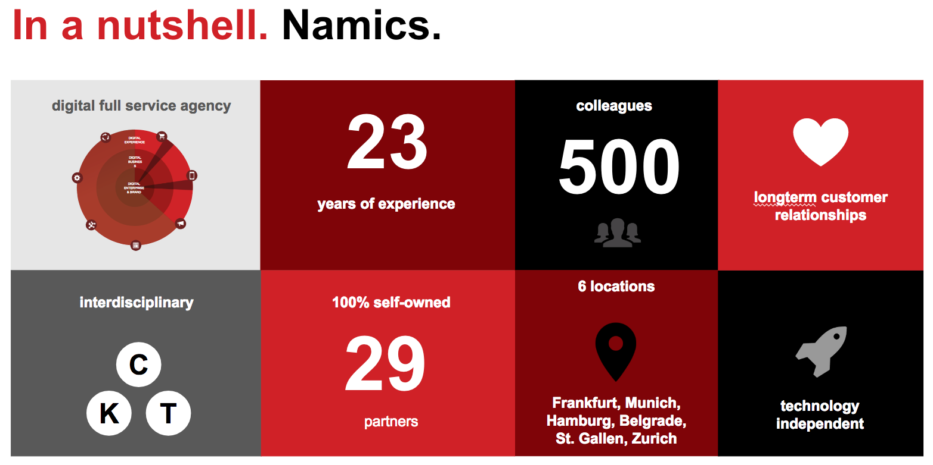
Thanks to Namics gmbh

Slide 5
Speakers needed!
Only two requirements:
In english
Tech/Dev topic (also softtopics)
Everyone is welcome
From the community for the community

Slide 6
Future of this meetup
Trying to host 3rd week of every Month
Summer-Break (July/aug)
Speakers from all over the world
Community events next to presentations (BBQ, Hackathons etc)

Slide 7
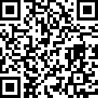
Lottery
After the presentation
Please join our meetup if you haven’t yet
https://www.meetup.com/English-speaking-developer-community-Hamburg/

Slide 8
SAFE Stack: The Pit of Success for Functional Web Programming - Isaac Abraham
Todays meetup

